Slide 1


FUTURE ACCOUNTANTS
The Accounting Profession and Artificial Intelligence: Leveraging Its Potential
From Automation to Audit Integrity—AI’s Impact on Accounting
Austin Weedor, MSc - JPMorgan Chase
August 2025
Jacob Ideji, MBA – Cisco Systems Inc

Slide 2


Key Concepts
The Fastest Tech Wave
AI technology is advancing at an unprecedented pace today.
Rising Client Expectations
Clients demand more transparency and quicker responses than ever.
Accountants in the Spotlight
Accountants are critical players in the digital transformation journey.

Slide 3



State of AI
in Accounting
Exploring AI's impact on the accounting industry

Slide 4

Key Metrics
Understanding the current landscape of AI in accounting is crucial.
1,200,000
AI Adoption Rate
Number of firms using AI tools today.
Client Expectations
75%
Percentage of clients demanding AI-enhanced services.
Notes:
Sources
https://www.businessinsider.com/ai-leaders-pwc-mastercard-accenture-ikea-tech-adoption-growth-strategy-2025-5
https://ff.co/ai-statistics-trends-global-market/
https://www.allaboutai.com/resources/ai-statistics/global-ai-adoption/
https://nypost.com/2025/07/15/tech/most-believe-ai-helps-small-businesses-compete-with-larger-firms/
https://www.demandsage.com/artificial-intelligence-statistics/
https://www.techradar.com/pro/tackling-ai-sprawl-in-the-modern-enterprise
https://www.mckinsey.com/capabilities/operations/our-insights/the-next-frontier-of-customer-engagement-ai-enabled-customer-service?utm_source=chatgpt.com
https://www.mncpa.org/resources/publications/footnote/august-september-2025/the-impact-of-ai-in-accounting-uses-and-automation/?utm_source=chatgpt.com
https://www.accountancyage.com/2024/06/10/accountants-using-ai/?utm_source=chatgpt.com
https://www.digitalwebkit.com/blogs/blog/1317885-navigating-client-expectations--ai-driven-strategies-for-service-based-businesses?utm_source=chatgpt.com

Slide 5


Understanding AI Concepts
Automation
Machine Learning
Automation refers to technology performing tasks without human intervention, enhancing efficiency in accounting processes.
Machine Learning is a subset of AI that enables systems to learn from data and improve over time.

Slide 6



Case Studies Overview
Global Insights
West Africa
  Big Four
  IFRS Automation
  Nigeria FIRS
  Ghana Audit Service
Notes:
Case Study 1: Sources: https://kpmg.com/us/en/media/news/kpmg-ai-integration-clara-2024.html?
https://www.ft.com/content/bd9c415f-cab5-4ae1-8bf2-a17c57f9b5db?
https://www.techmonitor.ai/digital-economy/ai-and-automation/accountancy-ai-big-four-ey?utm_source=chatgpt.com
AI in Accounting: 11 Benefits, Implementation Strategies, and Future Impact [2025]: https://www.accountingedu.org/exploring-the-benefits-of-ai-in-accounting/?utm_source=chatgpt.com
Case Study 2: Source: https://www.myjoyonline.com/smart-procurement-using-ai-to-combat-fraud-and-boost-efficiency-in-ghanas-public-spending/?utm_source=chatgpt.com#google_vignette
West Africa–Relevant Examples
AI in Ghana public procurement anomaly detection: AI flagging unusual pricing, collusion, etc., boosting efficiency in public-sector spending. MyJoyOnline
Digitalization improvements in the Audit Service of Ghana: Data analytics improved audit discrepancy detection by ~40%, and audit turnaround times reduced by ~30%. Dataprojectng.com+15researchgate.net+15audit.gov.gh+15
AI in Nigerian banking fraud detection: Banks are using AI for predictive analytics, anomaly detection, and reducing fraud exposure. arxiv.org+1
Ethics, Governance & Future Skills
Concerns around algorithmic bias, transparency, and governance in AI auditing: Highlighted in recent industry reports. Financial Times
PwC shifting junior accountant training toward oversight of AI systems: Reflects evolving roles and skills emphasis in audit. Source: Business Insider: https://www.businessinsider.com/pwc-ai-training-changing-the-job-accountants-jenn-kosar-2025-8?utm_source=chatgpt.com

Slide 7


Case Study Insights
1
2
3
Big Four firms adopt AI technologies
Local practices begin AI integration
Successful outcomes in West Africa

Slide 8





Ethics & Governance
Bias
Confidentiality
Overreliance
Oversight
Prejudice in algorithms impacting decision-making outcomes
Protection of sensitive information from unauthorized access
Dependence on AI outputs without human verification
Monitoring AI systems to ensure compliance and trust

Slide 9

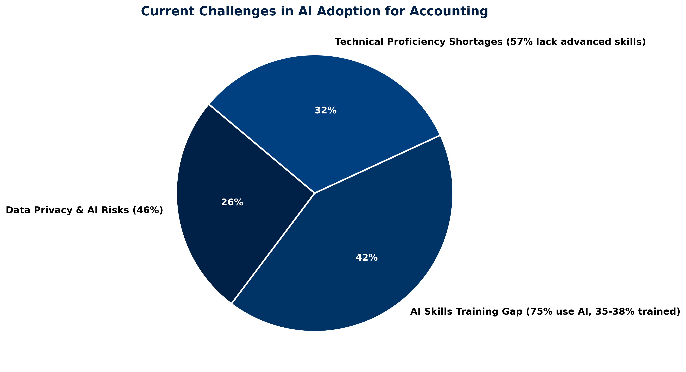
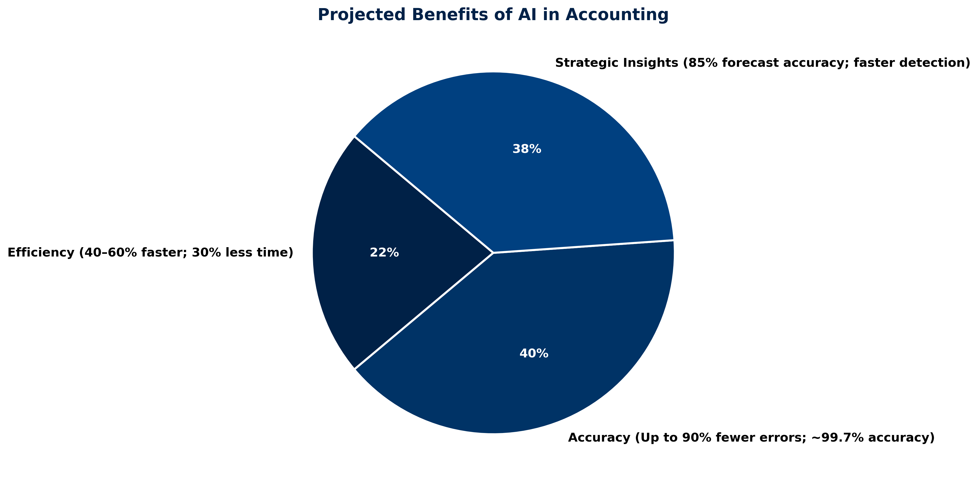
AI Brings Both Opportunities and Challenges.
Current Challenges Faced
Projected Benefits of AI
Data privacy and skill gaps
Enhanced efficiency and accuracy
Notes:
Sources
https://insights.trustarc.com/2025-global-privacy-benchmarks-report/?utm_source=chatgpt.com
https://www.forbes.com/councils/forbestechcouncil/2025/06/17/closing-the-ai-skills-gap-a-strategic-blueprint/?utm_source=chatgpt.com
https://softwareoasis.com/skills-gap-in-entry-level-accounting/?utm_source=chatgpt.com
https://usercentrics.com/guides/data-privacy/data-privacy-statistics/?utm_source=chatgpt.com
https://www.toolify.ai/ai-news/ai-impact-on-accounting-systems-enhancing-accuracy-efficiency-3630949
https://www.cpa.com/sites/cpa/files/2025-06/CPAcom-2025-AI-in-Accounting-Report.pdf
https://www.businessinsider.com/ey-consulting-accounting-less-boring-ai-2025-6?utm_source=chatgpt.com
https://virtuecpas.com/ai-in-accounting/?utm_source=chatgpt.com
https://www.ft.com/content/bd9c415f-cab5-4ae1-8bf2-a17c57f9b5db?utm_source=chatgpt.com
https://www.cpapracticeadvisor.com/2025/01/14/7-pain-points-ai-could-solve-for-accounting-and-finance-teams/154446/?utm_source=chatgpt.com

Slide 10
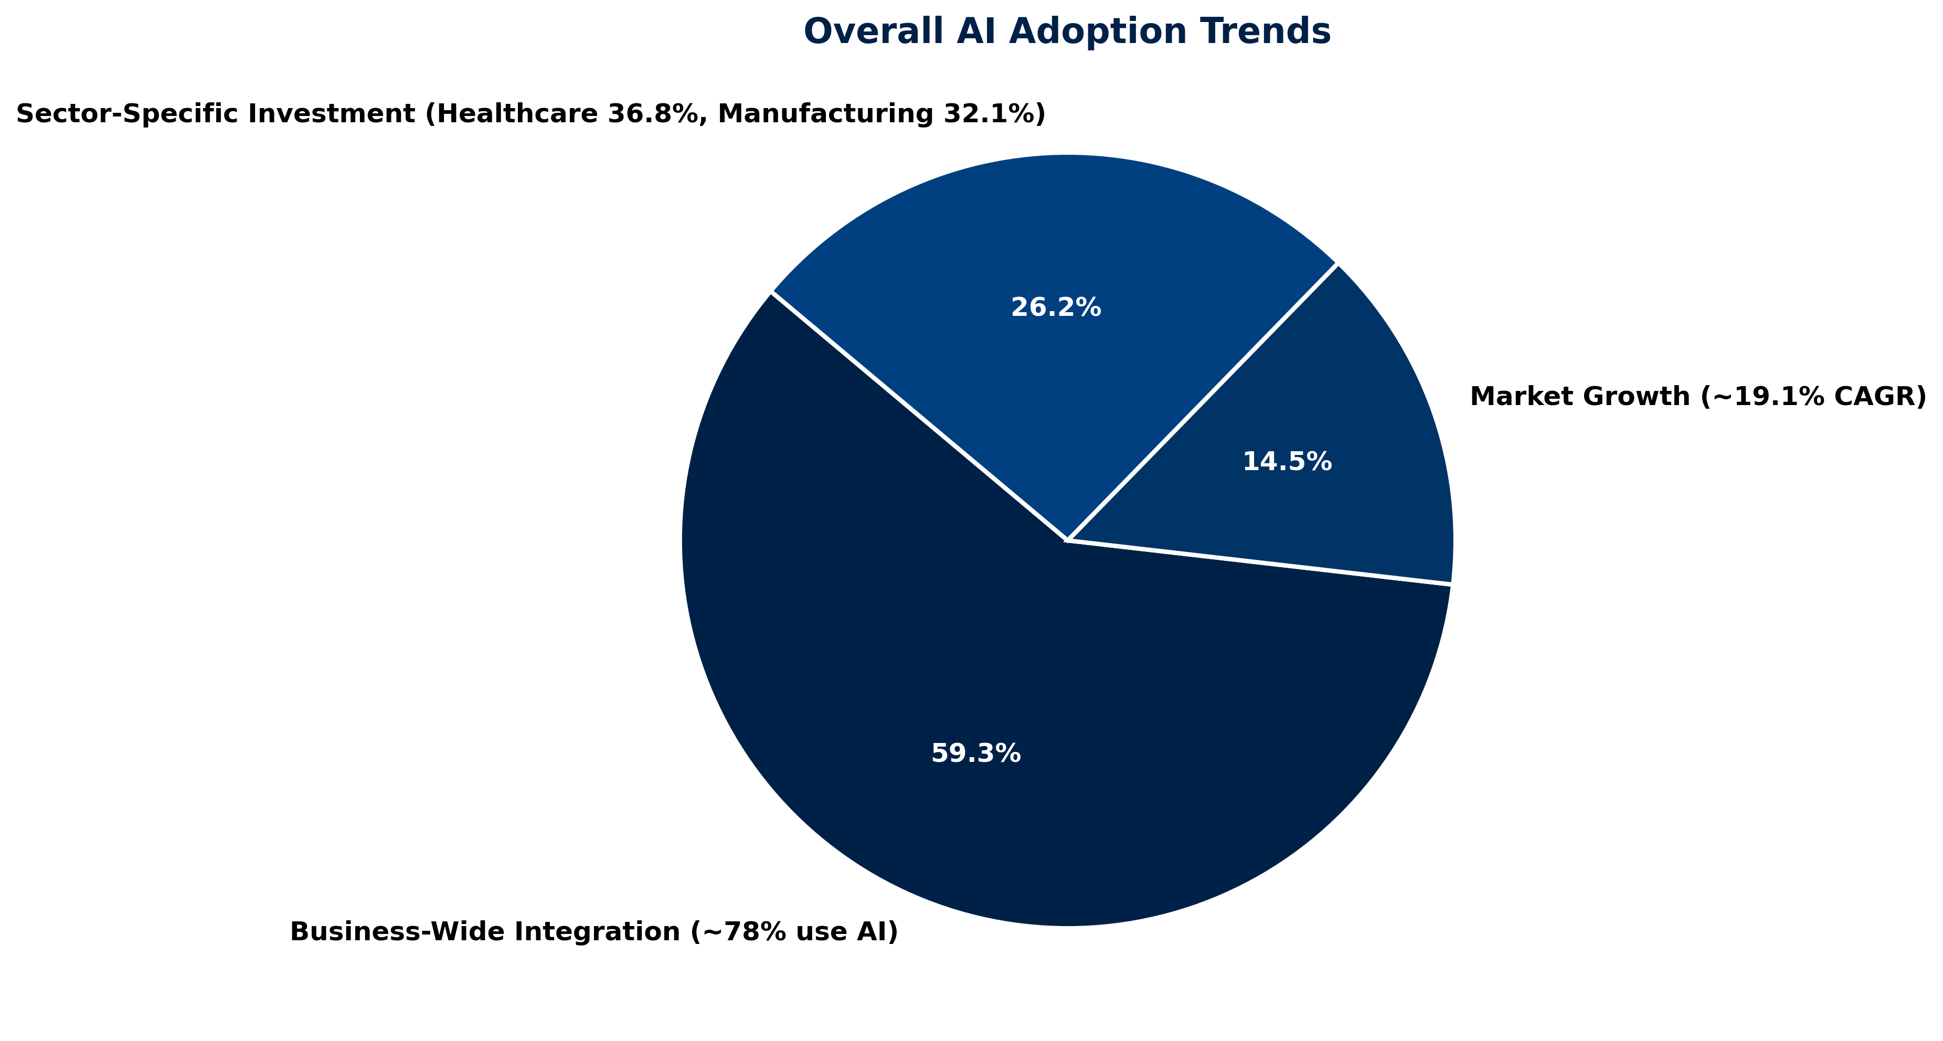
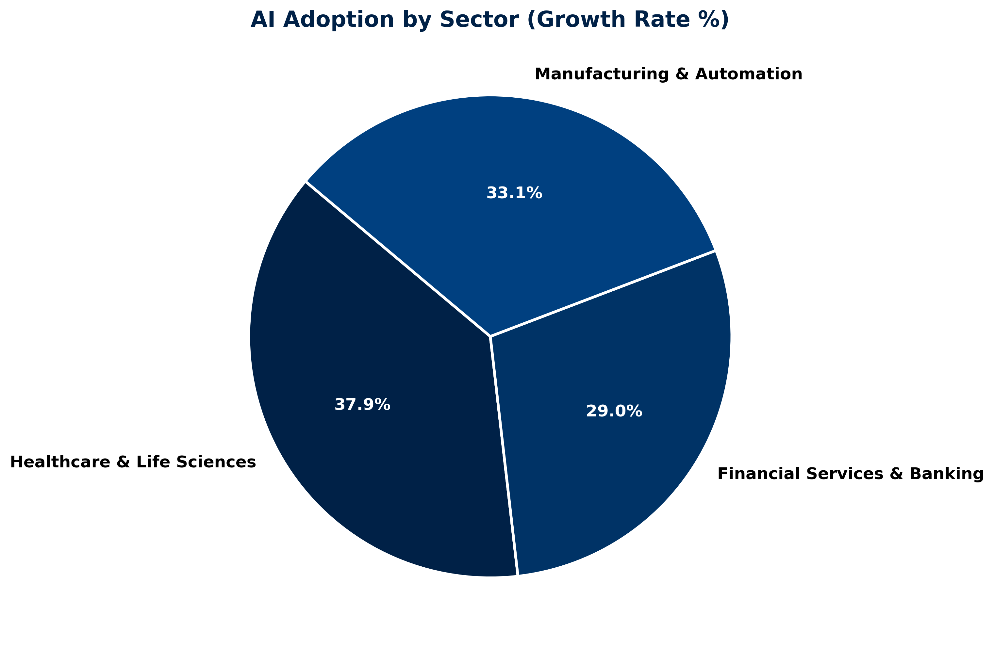
AI Becomes a Core Business Capability.
Overall, AI Adoption Trends
AI Adoption by Sector
General growth across various sectors
Key industries embracing AI rapidly
Notes:
AI adoption is no longer a niche experiment, it’s becoming a standard business capability across industries.
Overall, AI Adoption Trends:
We’re seeing steady, year-over-year growth in AI investment and implementation, with both large enterprises and smaller firms finding practical use cases.
The drivers? Competitive pressure, efficiency gains, and the push for better decision-making through data.
General Growth Across Sectors:
Healthcare is using AI for diagnostics and patient analytics, finance for fraud detection and portfolio management, and manufacturing for predictive maintenance.
Even sectors traditionally slower to adopt tech, like legal and government—are beginning to explore AI to improve workflows.
AI Adoption by Sector:
While tech companies were early adopters, other industries are catching up fast. For example, retail is using AI for personalized recommendations, and agriculture is leveraging it for precision farming.
Key Industries Embracing AI Rapidly:
Financial services, healthcare, and professional services are leading the charge, partly because they deal with high volumes of data and see immediate ROI.
Sources
https://www.byteplus.com/en/topic/516553?title=ai-adoption-statistics-2025-all-figures-and-facts&utm_source=chatgpt.com
https://www.accountingtoday.com/opinion/a-strategic-guide-to-gen-ai-adoption-in-corporate-finance-and-accounting?utm_source=chatgpt.com
https://www.businesswire.com/news/home/20250618827966/en/Artificial-Intelligence-AI-Market-Industry-Trends-and-Global-Forecasts-2025-2035-AI-Adoption-Accelerates-Across-Sectors-as-Investments-Surge-Amid-Rising-Demand-for-Automation-and-AGI-Development---ResearchAndMarkets.com?utm_source=chatgpt.com
https://www.macrosoftinc.com/ai-industry-survey-report-2025/?utm_source=chatgpt.com
https://www.novusasi.com/blog/mid-2025-snapshot-ai-adoption-by-industry?utm_source=chatgpt.com
https://www.forbes.com/sites/bernardmarr/2025/06/03/mind-blowing-ai-statistics-everyone-must-know-about-now-in-2025/?utm_source=chatgpt.com
https://hginsights.com/blog/ai-readiness-report-top-industries-and-companies?utm_source=chatgpt.com

Slide 11
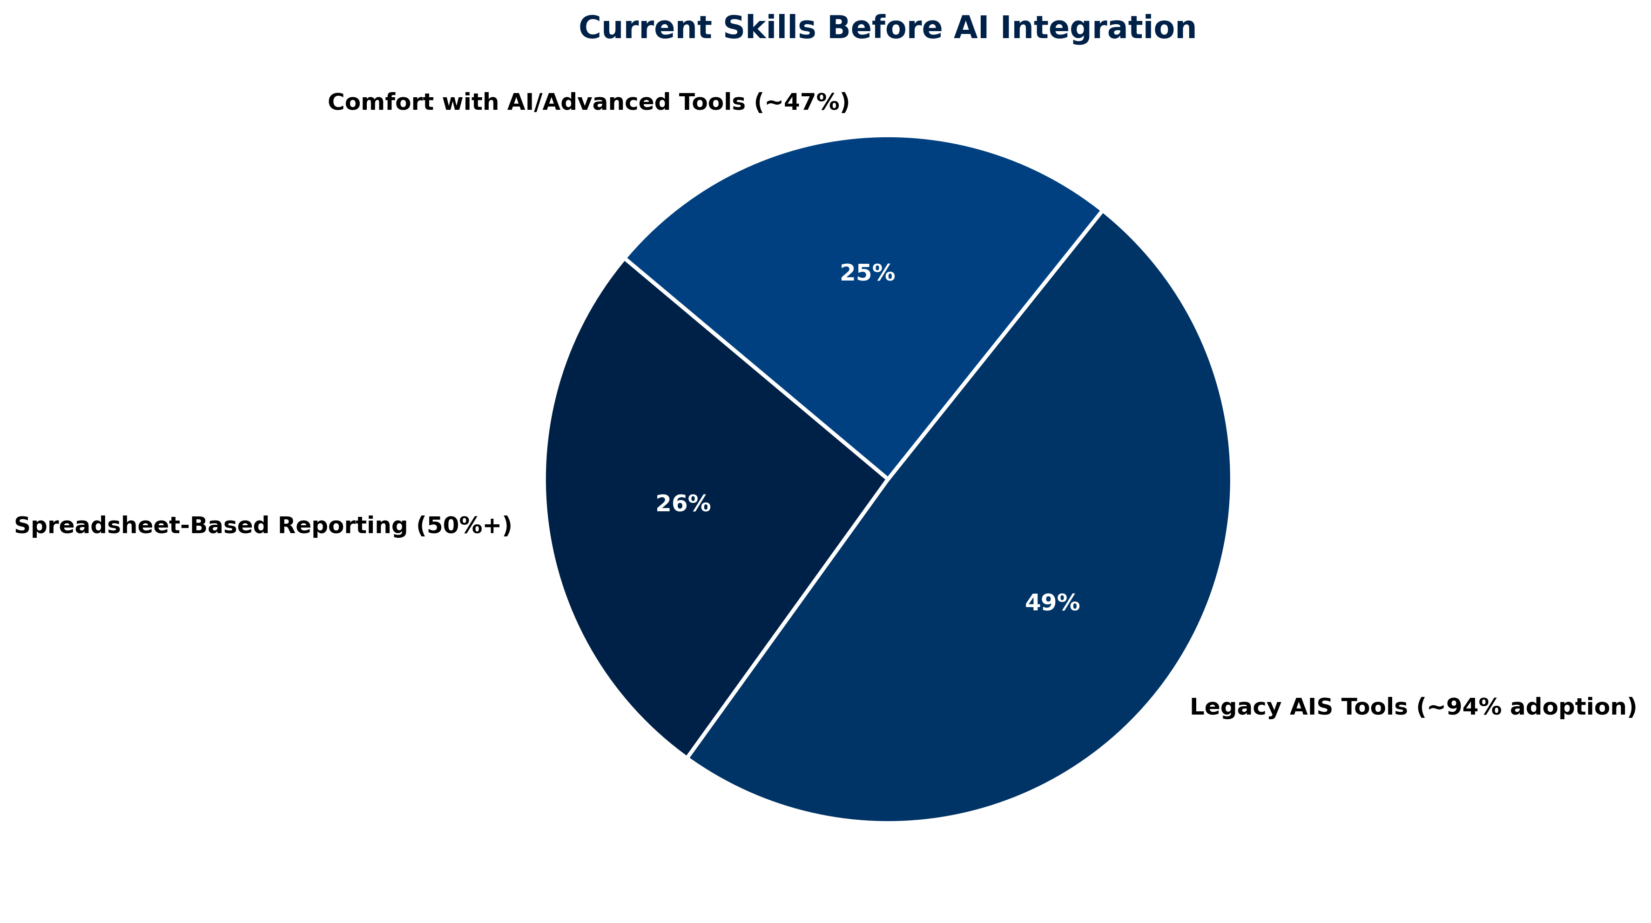
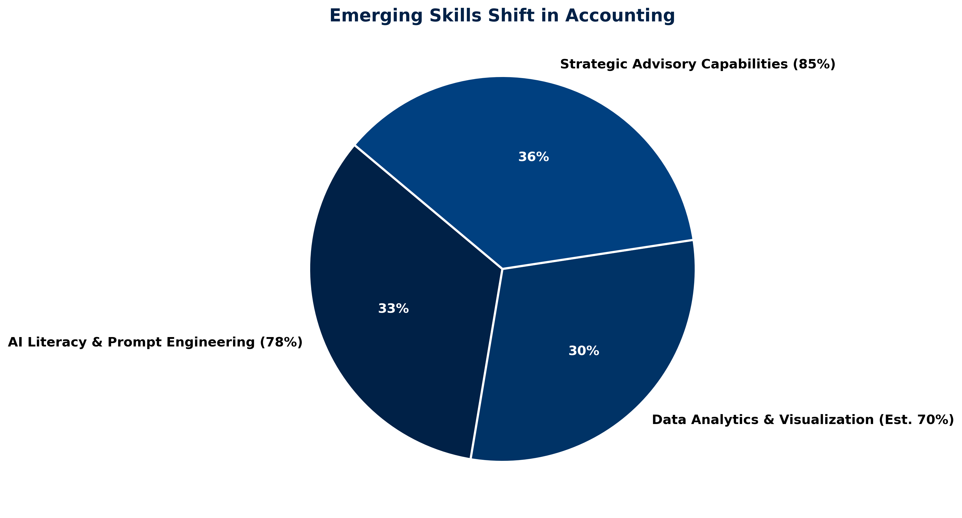
Evolving with AI: Where We’ve Been and Where We’re Going.
Skills Before AI Integration
Skills Shift Overview
Traditional skills dominate the landscape
Focus on emerging skills
Notes:
Sources
https://financialnewswire.com.au/accounting/accountants-want-more-ai-but-big-skills-gap-is-hampering-adoption-caw/?utm_source=chatgpt.com
https://www.theaccountant-online.com/news/chartered-accountants-embracing-ai-upskilling-needed/?utm_source=chatgpt.com
https://www.sciencedirect.com/science/article/abs/pii/S0040162525001362?utm_source=chatgpt.com
https://wjarr.com/sites/default/files/WJARR-2023-2721.pdf?utm_source=chatgpt.com
https://www.ais-cpa.com/important-accounting-statistics/
https://accountingprofessor.org/ai-in-accounting-what-students-and-professionals-must-know-for-2025-and-beyond/
https://www.cpa.com/sites/cpa/files/2025-06/CPAcom-2025-AI-in-Accounting-Report.pdf
https://subledger.app/blog/upskill-for-ai
https://accountancyrecruit.co.uk/blog/industry-insights-surveys/which-skills-are-in-demand-for-accountants-in-2025/

Slide 12
AI Adoption Timeline
Key milestones shaping the future of accounting professionals.
2022
2023
2024
2025
Accountants begin integrating AI tools into workflows.
AI-enhanced decision-making becomes standard practice for firms.
Implementation of AI ethics guidelines and best practices.
Transformation of client relationships through AI-powered insights.
Notes:
Sources
https://aiworkplace.com/finance/how-accounting-firms-are-integrating-ai-into-their-workflows/?utm_source=chatgpt.com
https://www.numeric.io/blog/ai-in-accounting?utm_source=chatgpt.com
https://tax.thomsonreuters.com/blog/how-ai-transformed-the-tax-and-accounting-profession-in-2023/?utm_source=chatgpt.com
https://www.thetaxadviser.com/issues/2023/dec/ai-and-the-importance-of-firm-oversight/?utm_source=chatgpt.com
https://www.cpa.com/sites/cpa/files/2025-06/CPAcom-2025-AI-in-Accounting-Report.pdf?utm_source=chatgpt.com
https://www.accountingcapital.com/accounting/the-future-of-accounting-how-ai-and-automation-are-changing-bookkeeping/?utm_source=chatgpt.com
https://www.forbes.com/councils/forbesbusinesscouncil/2023/11/22/unlocking-the-potential-of-ai-for-accounting-firms-and-clients/?utm_source=chatgpt.com
https://www.icpas.org/information/copy-desk/insight/article/digital-exclusive-2023/the-transformative-impact-of-ai-on-accounting?utm_source=chatgpt.com
https://link.springer.com/chapter/10.1007/978-3-031-46177-4_12?utm_source=chatgpt.com

Slide 13
What AI Can Achieve
01
02
03
Automate Tasks
Improve Accuracy
Unlock Insights
AI can streamline processes, allowing accountants to focus on strategic insights.
Leveraging AI enhances precision, reducing human error in financial data.
AI provides deeper analysis, revealing trends and opportunities for clients.

Slide 14

AI Limitations
Critical Factors
Understanding the nuance and context is essential for effective decision-making in accounting.
Key Areas of Concern
Essential Human Skills
Understand nuance and context
Replace ethical judgment
Fully manage client relationships
Emotional intelligence required
Ethical judgment needed
Relationship management crucial

Slide 15
What AI Can’t Do
Key limitations of AI in accounting practices
  Understand complex emotional nuances.
  Replace human ethical decision making.
  Fully manage client interactions effectively
  Navigate ambiguous situations with empathy.
  Build trust through personal relationships.

Slide 16
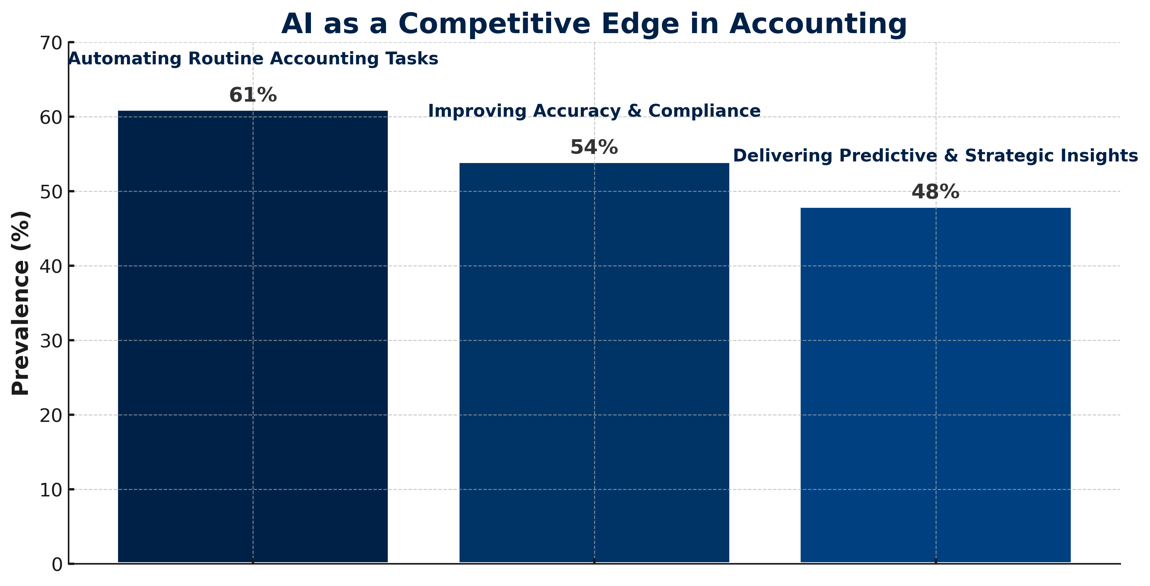
AI as a Competitive Edge: Strategies to Elevate Accounting
Embracing AI allows accountants to augment their expertise and create high-value services. By shifting roles from traditional historians to strategic partners, firms can leverage AI to enhance client relationships and drive greater business success.
Notes:
Sources
https://accountingforeveryone.com/adapting-to-change-how-accountants-can-thrive-in-an-ai-driven-industry/?utm_source=chatgpt.com
https://mitsloan.mit.edu/ideas-made-to-matter/how-generative-ai-can-make-accountants-more-productive?utm_source=chatgpt.com
https://smallbiztrends.com/accountants-embrace-ai-anticipate-strategic-advisory-boom-amid-challenges/?utm_source=chatgpt.com
https://www.morningstar.com/news/business-wire/20250730613391/accountants-embrace-ai-and-strategic-advisory-services-to-fuel-growth-yet-continue-to-face-tech-and-talent-barriers-according-to-2025-intuit-quickbooks-survey?utm_source=chatgpt.com
https://www.glasscubes.co.uk/7-best-ai-for-accountants-to-streamline-client-engagement/?utm_source=chatgpt.com
https://report.woodard.com/articles/how-accountants-can-use-ai-to-serve-clients-better-twwr-oaiwr-ocewr?utm_source=chatgpt.com
https://www.accountancyage.com/2024/06/10/accountants-using-ai/?utm_source=chatgpt.com
https://www.forbes.com/sites/neilsahota/2024/04/22/the-dawn-of-a-new-era-ais-revolutionary-role-in-accounting/?utm_source=chatgpt.com

Slide 17
3 out of 3
All key services are enhanced by AI.
85%
Accountants believe AI improves their work efficiency.
2 million
New services expected with AI integration.
Notes:
Sources
https://www.accountingcapital.com/accounting/the-future-of-accounting-how-ai-and-automation-are-changing-bookkeeping/?utm_source=chatgpt.com
https://bmoandco.com/resources/the-future-of-accounting%3A-how-automation-and-ai-are-reshaping-financial-services?utm_source=chatgpt.com
https://news.stanford.edu/stories/2025/06/ai-accounting-bookkeeping-benefits-jobs?utm_source=chatgpt.com
https://techxplore.com/news/2025-07-ai-accounting-efficiency-jobs.html?utm_source=chatgpt.com
https://mitsloan.mit.edu/ideas-made-to-matter/how-generative-ai-can-make-accountants-more-productive?utm_source=chatgpt.com
https://www.cpa.com/sites/cpa/files/2025-06/CPAcom-2025-AI-in-Accounting-Report.pdf?utm_source=chatgpt.com
https://www.cpapracticeadvisor.com/2025/04/03/ai-in-accounting-moving-beyond-adoption-to-enhance-client-outcomes/158495/?utm_source=chatgpt.com
https://www.prnewswire.com/news-releases/study-69-percent-of-accountants-said-ai-has-a-positive-impact-on-the-profession-302008419.html?utm_source=chatgpt.com
https://serviceorca.com/article/the-integration-of-ai-in-modern-accounting-programs-transforming-financial-management?utm_source=chatgpt.com
https://www.cfobrew.com/stories/2025/06/13/public-accounting-leaders-lay-out-process-for-ai-integration?utm_source=chatgpt.com

Slide 18
Your 90 Day Action Plan
Phase / Weeks | Goal | Key Actions | Responsible | Success Metric
Weeks 1 - 2: Assessment and Planning | Understand client needs and compliance requirements | Review client portfolios, identify regulatory deadlines, assess software/tools in use | Senior Accountant / Partner | Comprehensive plan document approved
Weeks 3 - 4: Process Optimization | Improve efficiency and accuracy in workflows | Automate repetitive tasks, streamline data entry, standardize file naming and archiving | Operations Lead / Accounting Team | 20% reduction in processing time
Weeks 5- 6: Technology and AI Integration | Leverage AI to enhance services | Implement AI tools for forecasting, anomaly detection, and report generation | IT & Finance Technology Team | AI-generated reports validated by accountants
Weeks 7- 8: Client Engagement and Advisory | Strengthen client relationships | Schedule advisory meetings, provide insights from AI analytics, upsell value-added services | Client Relationship Manager / Partner | Positive feedback and increased service uptake
Weeks 9 - 12: Review and Continuous Improvement | Measure outcomes and set long-term strategies | Evaluate KPIs, gather team and client feedback, create ongoing improvement plan | Leadership Team | ll KPIs met or exceeded

Slide 19

Embrace AI for a more efficient future

Slide 20

“Make AI your ally in delivering greater value to the Accounting Profession”
– Closing Call to Action

Slide 21


THANK YOU
Reach out for more
Social Media
https://www.linkedin.com/in/austinweedor//
https://www.linkedin.com/in/jacobideji/
Authors of the following work:

